Slide 1
Program
MineOperate Technical Level 1
Key database tables functions, etc.
Edgar Sepulveda
Global Technical Manager, MineOperate
10/10/2022
Version 1.3

Slide 2

Purpose
This session …
​At the end of this module, you will:

Slide 3
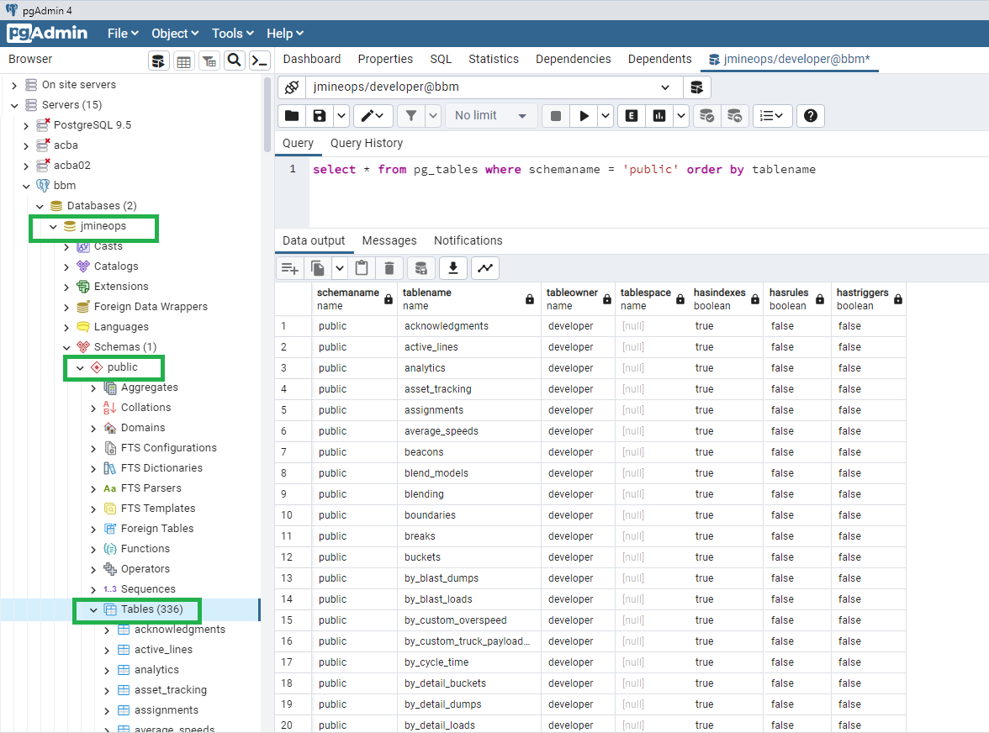
Key database tables and functions
jmineops tables

Slide 4
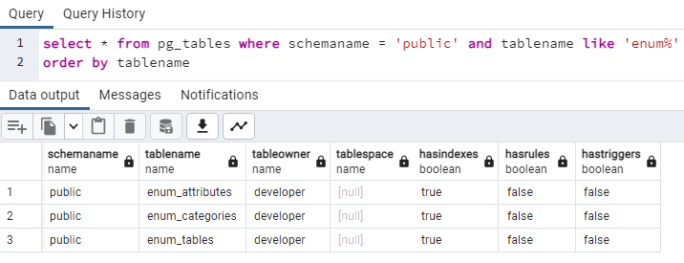
Key database tables and functions
Enum tables

Slide 5
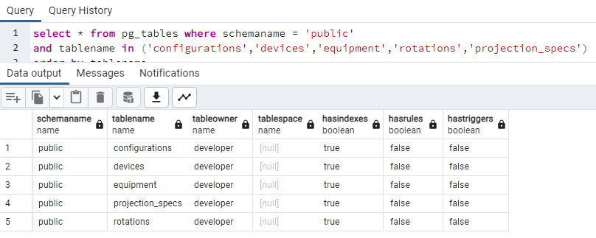
Key database tables and functions
Configuration tables

Slide 6
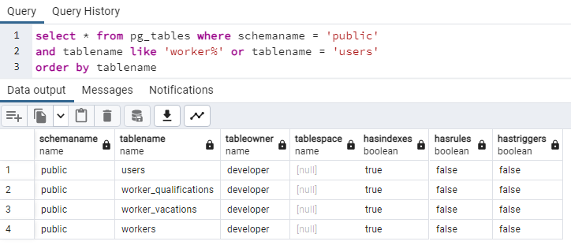
Key database tables and functions
Users and workers tables

Slide 7
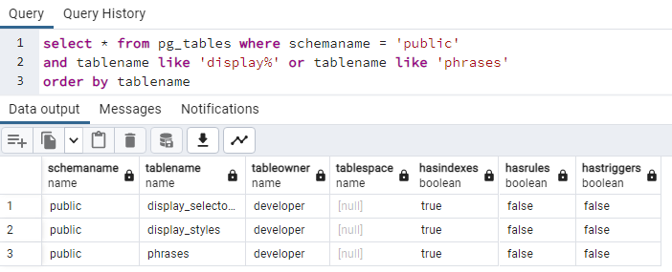
Key database tables and functions
UI tables

Slide 8
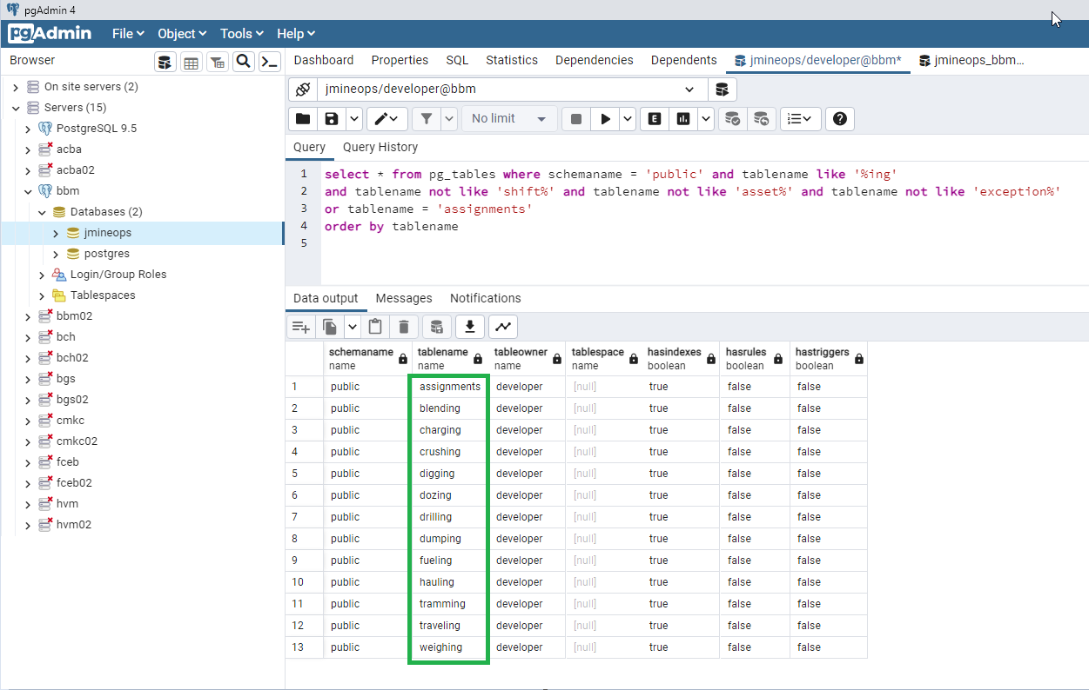
Key database tables and functions
Real-time tables

Slide 9
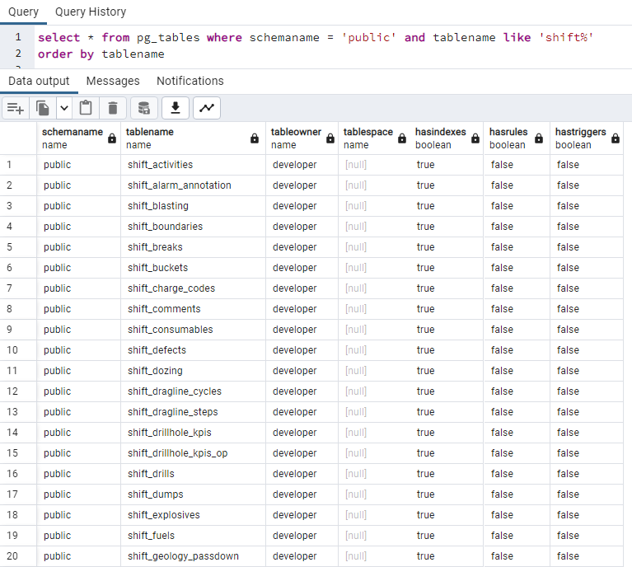
Key database tables and functions
Historical tables

Slide 10
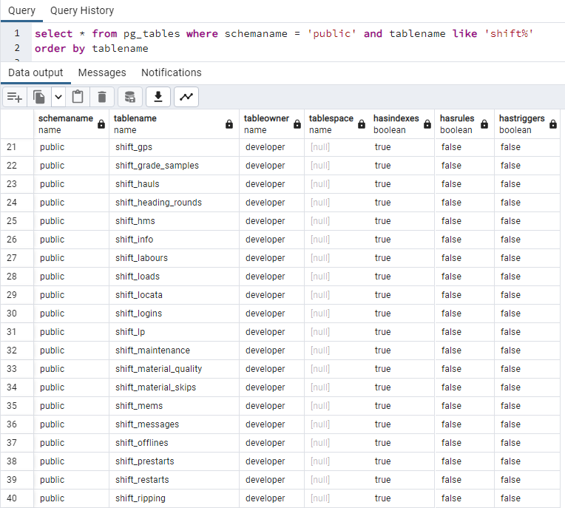
Key database tables and functions
Historical tables

Slide 11
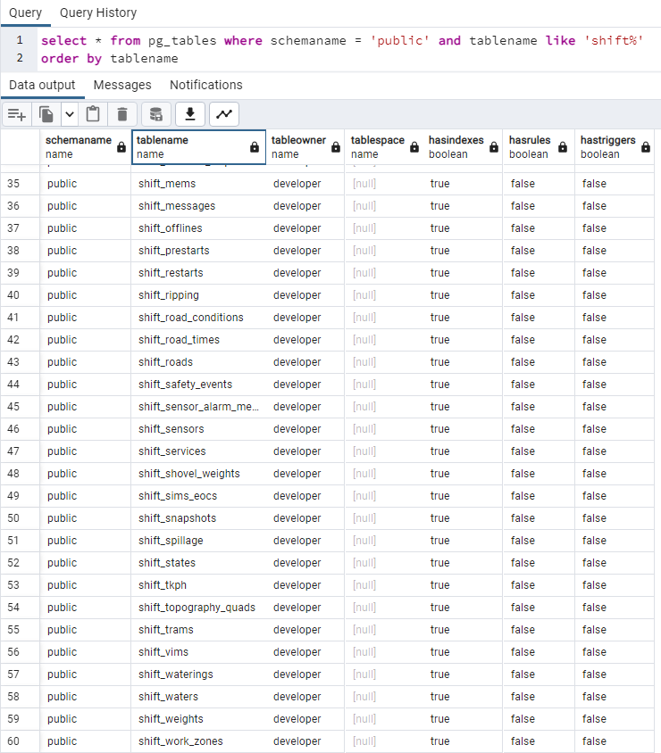
Key database tables and functions
Historical tables

Slide 12
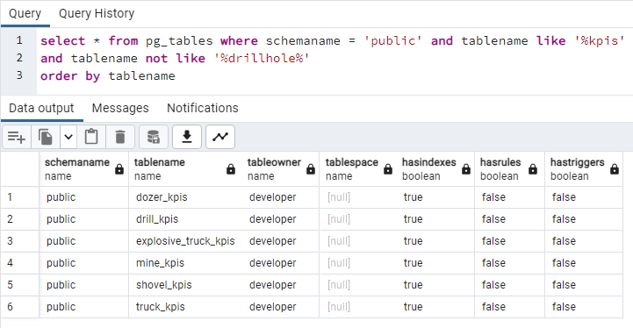
Key database tables and functions
KPIs tables

Slide 13
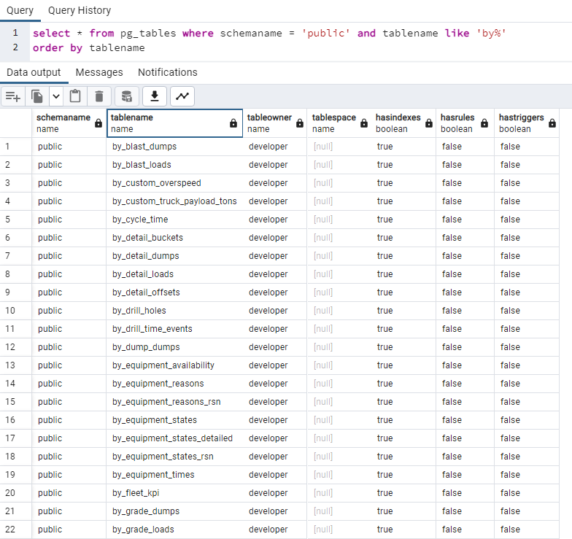
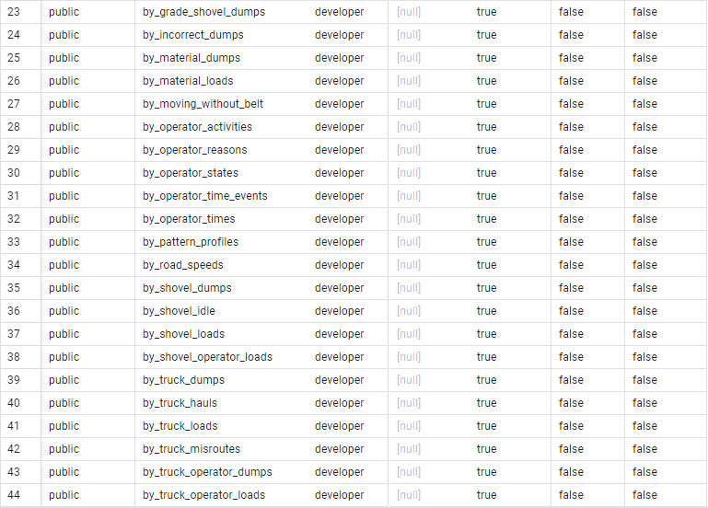
Key database tables and functions
Summary tables - by shift

Slide 14
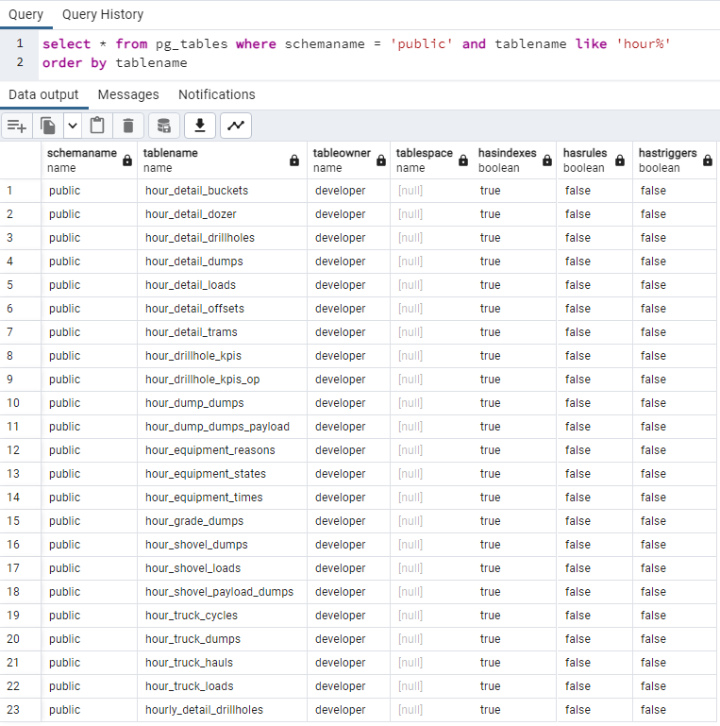
Key database tables and functions
Summary tables – by hour

Slide 15
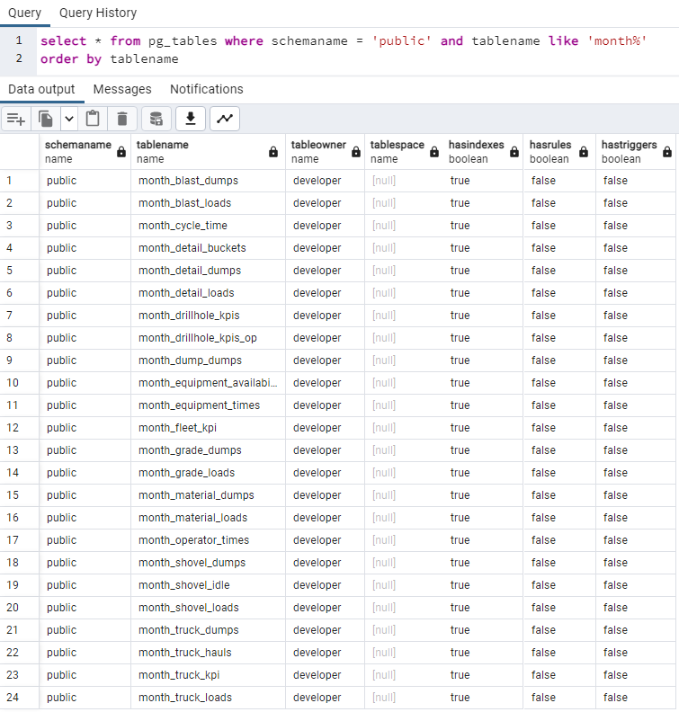
Key database tables and functions
Summary tables – by month

Slide 16
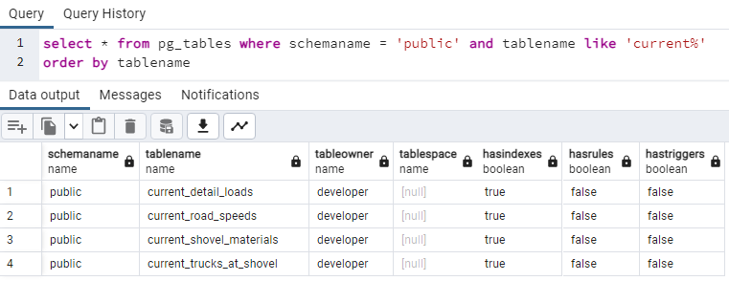
Key database tables and functions
Summary tables – current shift

Slide 17
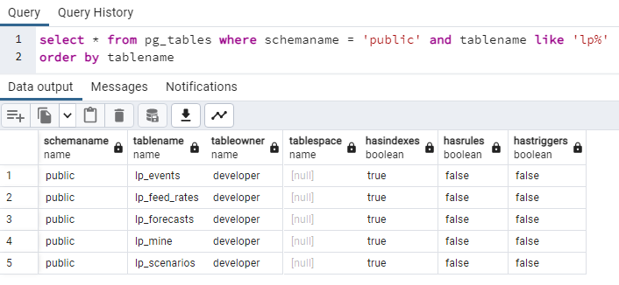
Key database tables and functions
LP tables

Slide 18
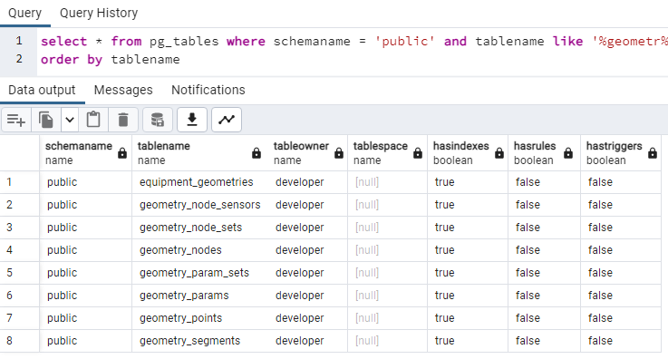
Key database tables and functions
Geometry tables

Slide 19
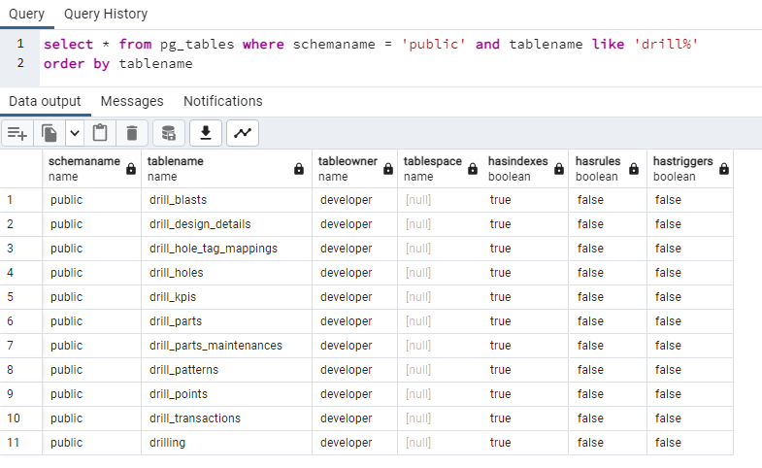
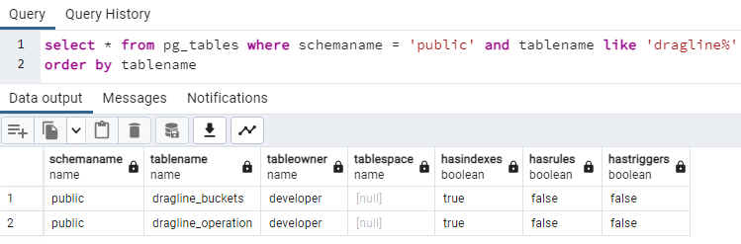
Key database tables and functions
Tables by product

Slide 20
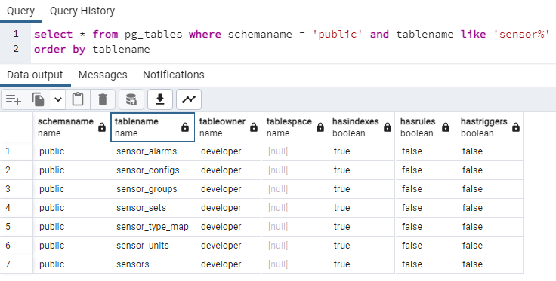
Key database tables and functions
Sensor tables

Slide 21
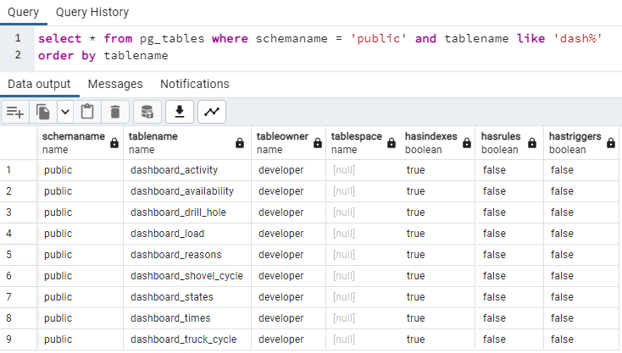
Key database tables and functions
Dashboard tables

Slide 22
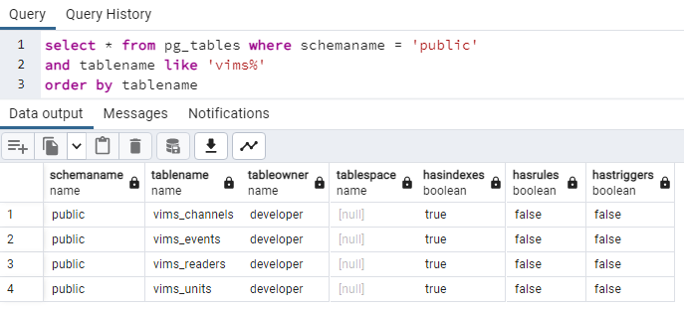
Key database tables and functions
VIMS tables

Slide 23
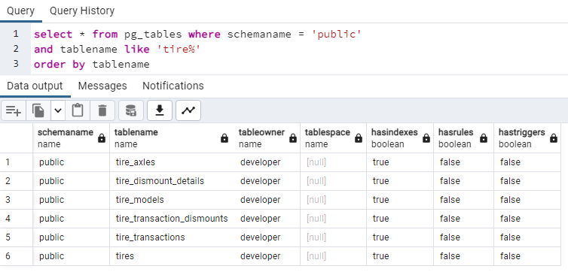
Key database tables and functions
Tires tables

Slide 24
Support Process - Questions

Slide 25
Support Process - Answers to Questions

Slide 26

THANK
Y
O
U

